Slide 1

Abra-Bawk-Dabra
Kelly Abramowitz, Jack Shen, Ben Filbert

Slide 2
Overview
Player takes the role of a chicken wizard
Exploratory platformer where the player explores to find new pieces to use in the puzzle
Tetris-esque puzzles as Boss fights

Slide 3
Specifications
PC game
Using GameMaker
Lighthearted & Humorous platforming and puzzle game

Slide 4
Plot
A wizard who was turned into a chicken
Wants to be human again
Collect pieces in the platformer to help in the puzzle game
Fight the dragon to get the potion to be made human again

Slide 5
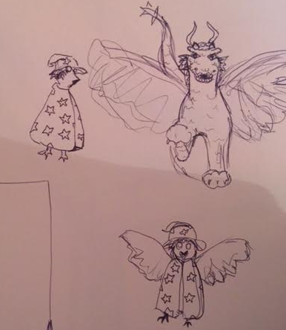


Art & Characters
Happy & Colorful
Clucky (PC)
Spike (Boss)

Slide 6
Gameplay - Platforming
Run & jump mechanics
Mid-air ‘course correct’
Avoid obstacles (arrows, stakes)
Exploration & Hidden objectives
Power-ups that affect the puzzle section
Collect missing pieces

Slide 7
Gameplay - Puzzle
Defend against boss attacks by stacking a barrier (not too high!)
Default shape roster can be added upon by finding the missing pieces in the platformer part
Use collected power-ups to your advantage

Slide 8
Puzzle Shapes
Default
Collected

Slide 9
Controls
Platforming
Puzzle Fights
[A][D]: Left/Right Movement [SPACE]/[W]: Jump [S]: Crouch
[A][D]: Move block left/right [W]: Rotate block [S]: Increased fall speed [SPACE]: Drop block [C]: Hold Block [1][2][3]: Utilize powerup

